Slide 1
Priority Queue
Charles W. Kann

Slide 2
Overview
Binary trees with total and partial ordering
Complete binary tree
  Perfect tree
  Complete binary tree
  Storing complete binary tree and storage in arrays
  Heap order property
Priority Queue
  insert
  deleteFirst
Huffman tree and encoding

Slide 3
Total Ordering
In mathematics, a total order is a binary relation on some set X, which is antisymmetric, transitive, and a connex relation.
Formally
  Antisymmetry : If a ≤ b and b ≤ a then a = b;
  Transitivity : If a ≤ b and b ≤ c then a ≤ c
  Connexity : a ≤ b or b ≤ a.

Slide 4
Total Ordering – Binary Search Tree (BST)
Binary Search Tree is a node-based binary tree data structure which has the following properties:
  The left subtree of a node contains only nodes with keys lesser than the node’s key.
  The right subtree of a node contains only nodes with keys greater than the node’s key.
  The left and right subtree each must also be a binary search tree.

Slide 5
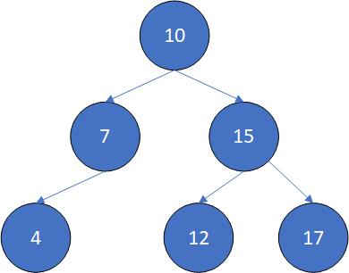
BST Example

Slide 6
Partial Ordering
In mathematics a partial order is any binary relation that is reflexive (each element is comparable to itself), antisymmetric (no two different elements precede each other), and transitive (the start of a chain of precedence relations must precede the end of the chain).
  if a ≤ b and b ≤ a, then a = b
  if a ≤ b and b ≤ c, then a ≤ c
Note no connexity, e.g. not all pairs are related.

Slide 7
Partial Ordering – Binary Heap
A binary heap is a complete binary tree which satisfies the heap ordering property. The ordering can be one of two types:
  the min-heap property: the value of each node is greater than or equal to the value of its parent, with the minimum-value element at the root.
  the max-heap property: the value of each node is less than or equal to the value of its parent, with the maximum-value element at the root.
Only need one type of BinaryHeap as the difference between a min-heap and max-heap can be handled by the Comparable or an appropriate Comparator.
Heap simply means pile. So you can have different types of heaps.
  Specifically a binary heap is not related to heap memory, or any other types of heap

Slide 8
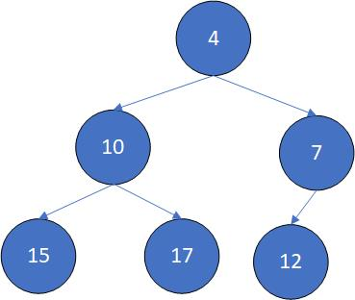
Heap Example

Slide 9
Other Binary Tree Definitions
Perfect Binary Tree – tree of height n which contains 2^{n}-1 nodes.
  Simply, a binary tree of height n where all nodes at height n-1 have 2 children, and all nodes at height n have no children.
Complete Binary Tree – A n-height Perfect Binary Tree to which nodes are always added to level n+1 in the left most open position; and nodes are always removed at the right most position on level n+1.

Slide 10
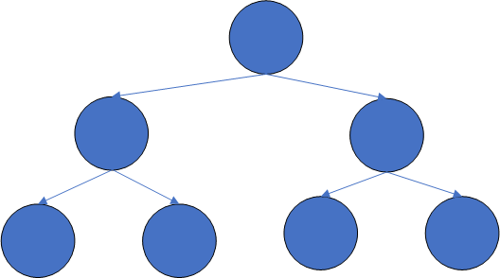
Perfect Tree

Slide 11
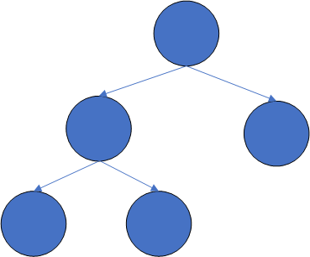
Complete Binary Tree

Slide 12
Advantage of CBT – Can be stored in array
A tree of N nodes requires an array of size N+1
  Always start with node 1 to more easily calculate parents and children
  Arbitrary tree requires 2^{N} nodes, so do not use an array for an arbitrary tree.
Parents are always (node number/2)
Child(ren) are always (node number * 2) and ((node number * 2) + 1)

Slide 13
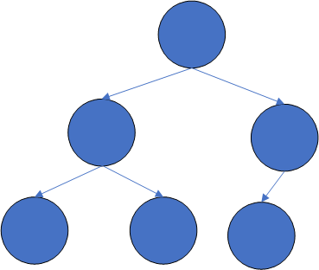
Complete Binary Tree

Slide 14
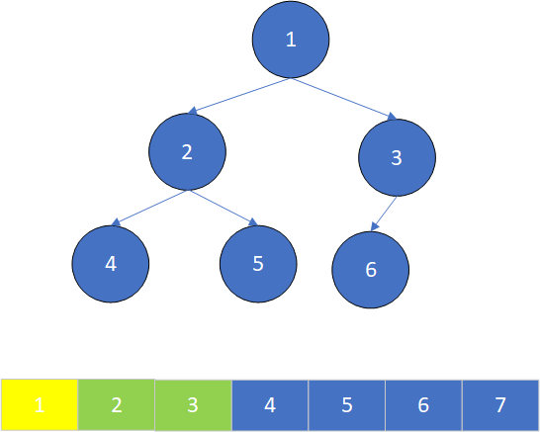
Complete Binary Tree - Parent/Child relationships in array – Node 1 - 2,3 (children)

Slide 15
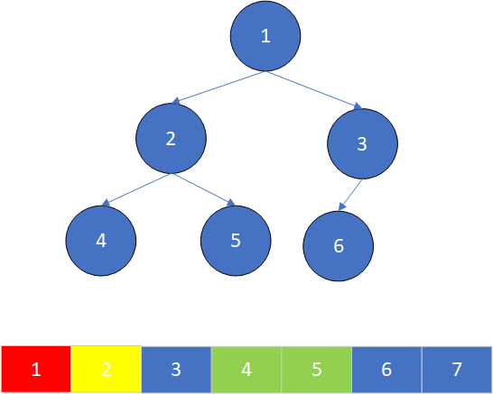
Complete Binary Tree - Parent/Child relationships in array – Node 2 - 1 (parent)/2,3 (children)

Slide 16
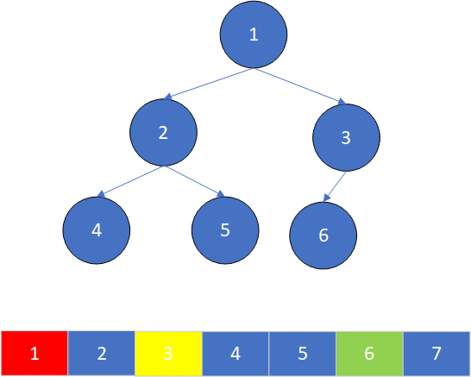
Complete Binary Tree - Parent/Child relationships in array – Node 3 - 1 (parent)/6 (child)

Slide 17
BinaryHeap
As defined earlier, a BinaryHeap is a CBT with a heap order property, e.g. the children are always less than the parent (max-heap) or the children are always greater than the parent (min-heap)
A binary heap is a partial ordering.
  The axioms for a non-strict partial order state that the relation ≤ is reflexive, antisymmetric, and transitive. That is, for all a, b, and c in P, it must satisfy:
  a ≤ a (reflexivity: every element is related to itself).
  if a ≤ b and b ≤ a, then a = b (antisymmetry: two distinct elements cannot be related in both directions).
  if a ≤ b and b ≤ c, then a ≤ c (transitivity: if a first element is related to a second element, and, in turn, that element is related to a third element, then the first element is related to the third element).

Slide 18
Inserting into a Binary Heap – min-heap
Add new node at the left most node on last level.
Bubble-up the node to the correct position in the tree.
Problem – insert 15, 17, 10, 7, 12, and 4

Slide 19

Binary Heap 1

Slide 20
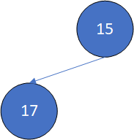
Binary Heap 2

Slide 21
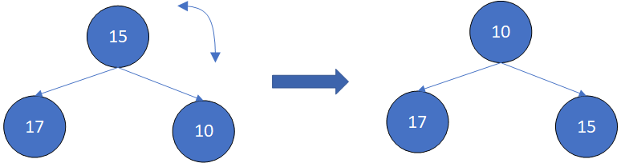
Binary Heap 3

Slide 22
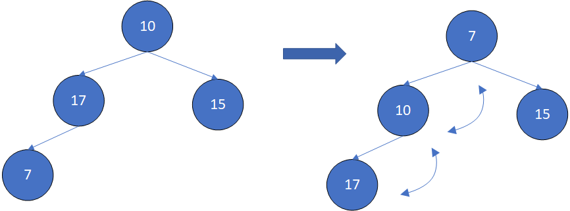
Binary Heap 4

Slide 23
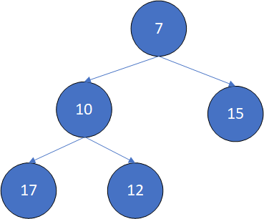
Binary Heap 5

Slide 24
Binary Heap 6

Slide 25
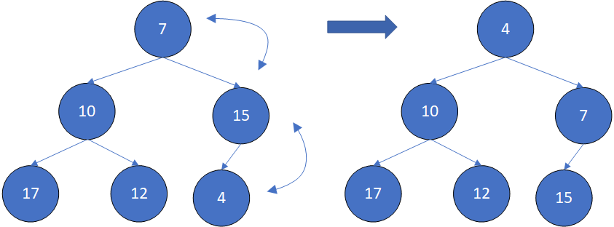
Binary Heap 7

Slide 26
DeleteFirst
Dequeue the minimum (maximum) value in queue. This is the root.
Move the last node to the root.
Bubble-down the node to the correct place.

Slide 27
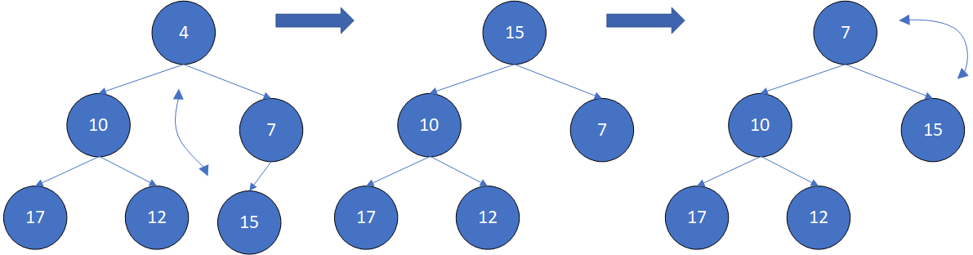
DeleteFirst

Slide 28
Huffman Code Generation
Count the number of occurrences of each character
Build a PriorityQueue on the letter frequency
Do until PriorityQueue has one element
  Pop two nodes.
  Add frequencies
  Push a new node, with the children being the popped nodes, and the frequency being the added frequency.
Pop the last node, this is the root of the Huffman tree
Recursively walk the tree and store the Huffman code with the character.

Slide 29
Code to count Frequency
public static int[] countFrequency(String s) {
int[] frequency = new int[256];
for(int i = 0, n = s.length() ; i < n ; i++) {
char c = s.charAt(i);
frequency[c]++;
}
return frequency;
}

Slide 30
Count Occurrences
Character | Frequency
a | 10
e | 15
i | 12
s | 3
t | 4
space | 13
newline | 1

Slide 31

Create Array of items

Slide 32
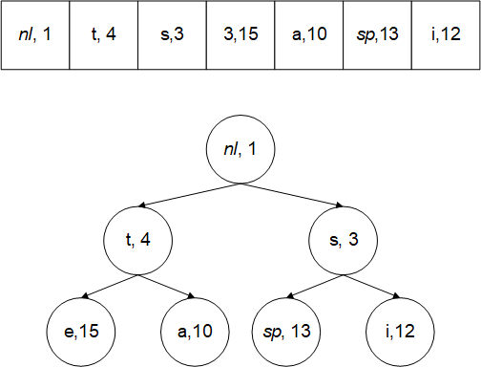
Build a min-head (priority queue) from the data

Slide 33
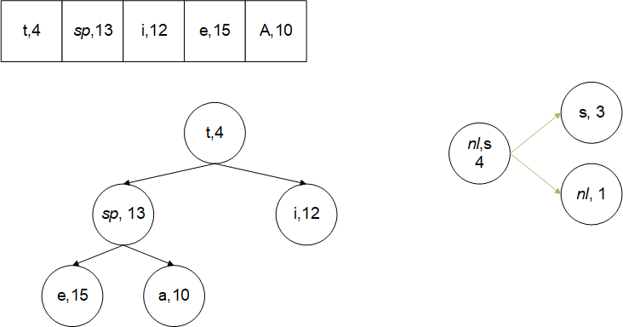
Delete two smallest nodes and combine

Slide 34
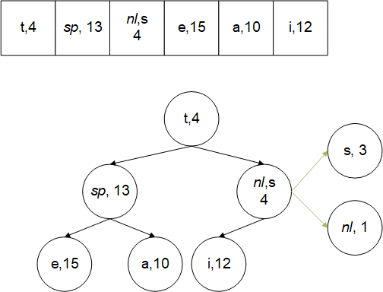
Push new node on min heap. Note that the new Node is part of head, and growing a tree

Slide 35
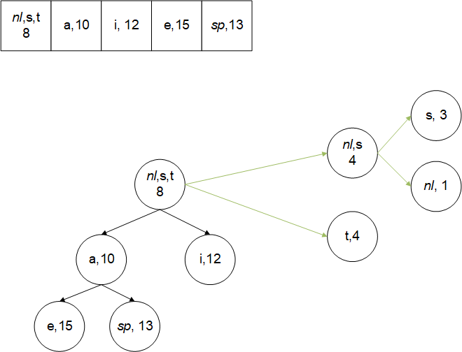
Repeat until one node is left. This is the Huffman tree

Slide 36
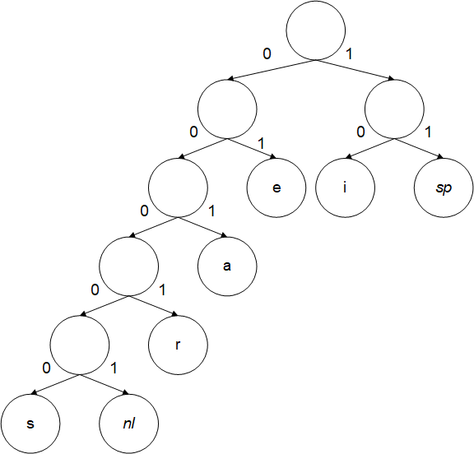
Walk Huffman tree to build code

